Slide 1
Metal Oxide Semiconductor Field Effect Transistor
(MOSFET)

Slide 2
MOSFET
MOSFET is a field-effect transistor with a MOS (metal oxide semiconductor) structure.
A field effect transistor (FET) that can be operated in the enhancement-mode is called a MOSFET. A MOSFET is an important semiconductor device and can be used in any of the circuits covered for JFET. However, a MOSFET has several advantages over JFET including high input impedance and low cost of production.
Types of MOSFET: There are two basic types of MOSFET: Depletion-type MOSFET or D-MOSFET: The D-MOSFET can be operated in both the depletion mode and the enhancement mode. For this reason, a D-MOSFET is sometimes called depletion/enhancement MOSFET. Enhancement-type MOSFET or E-MOSFET: The E-MOSFET can be operated only in enhancement mode. The manner in which a MOSFET is constructed determines whether it is DMOSFET or EMOSFET.
Prepared by Ipshita Tasnim Raha

Slide 4


Slide 8
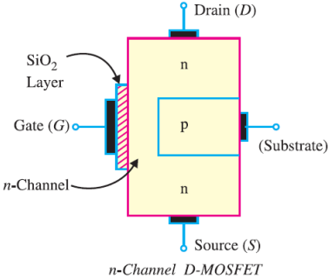
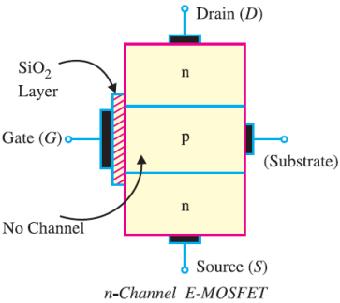
D-MOSFET Construction
The given figure shows the constructional details of n-channel D-MOSFET. It is similar to n-channel JFET except with the following modifications/remarks : (i) The n-channel D-MOSFET is a piece of n-type material with a p-type region (called substrate) on the right and there is an insulated gate on the left. The free electrons flowing from source to drain must pass through the narrow channel between the gate and the p-type region. (ii) Note carefully the gate construction of D-MOSFET. A thin layer of metal oxide (usually silicon dioxide, SiO2) is deposited over a small portion of the channel. A metallic gate is deposited over the oxide layer. As SiO2 is an insulator, therefore, gate is insulated from the channel. Note that the arrangement forms a capacitor. One plate of this capacitor is the gate and the other plate is the channel with SiO2 as the dielectric. Recall that we have a gate diode in a JFET.
Prepared by Ipshita Tasnim Raha
Notes:
Reference book: Vk Mehta – pg 535

Slide 9
D-MOSFET
(iii) It is a usual practice to connect the substrate to the source (S) internally so that a MOSFET has three terminals, they are, source (S), gate (G), and drain (D). (iv) Since the gate is insulated from the channel, we can apply either negative or positive voltage to the gate. Therefore, D-MOSFET can be operated in both depletion mode and enhancement mode.
However, JFET can be operated only in depletion mode.
Prepared by Ipshita Tasnim Raha

Slide 10
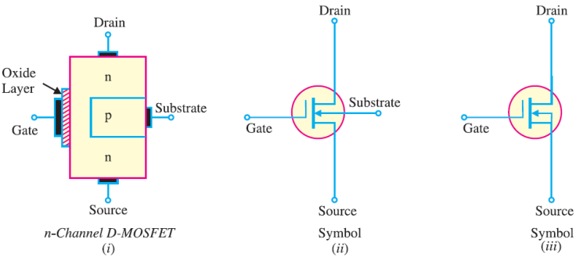
(i) n-channel D-MOSFET
Figure (i) shows the various parts of n-channel D-MOSFET. The p-type substrate constricts the channel between the source and drain so that only a small passage remains at the left side. Electrons flowing from source (when drain is positive with respect to source) must pass through this narrow channel. The symbol for n-channel D-MOSFET is shown in Figure (ii). The gate appears like a capacitor plate. Just to the right of the gate is a thick vertical line representing the channel. The drain lead comes out of the top of the channel and the source lead connects to the bottom. The arrow is on the substrate and points to the n-material, therefore we have n-channel DMOSFET. It is a usual practice to connect the substrate to source internally as shown in Figure (iii). This gives rise to a three-terminal device.
Prepared by Ipshita Tasnim Raha

Slide 11
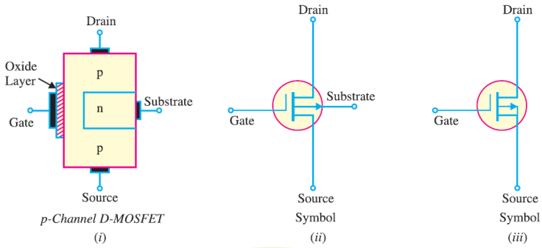
(ii) p-channel D-MOSFET
Figure (i) shows the various parts of p-channel D-MOSFET. The n-type substrate constricts the channel between the source and drain so that only a small passage remains at the left side. The conduction takes place by the flow of holes from source to drain through this narrow channel. The symbol for p-channel D-MOSFET is shown in Figure (ii). It is a usual practice to connect the substrate to source internally. This results in a three-terminal device whose schematic symbol is shown in Figure (iii).
Prepared by Ipshita Tasnim Raha

Slide 12
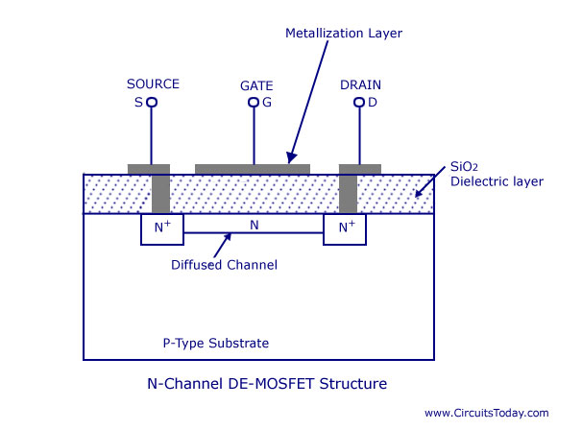
D-MOSFET Construction
Prepared by Ipshita Tasnim Raha
Notes:
Reference book: Vk Mehta – pg 535

Slide 13
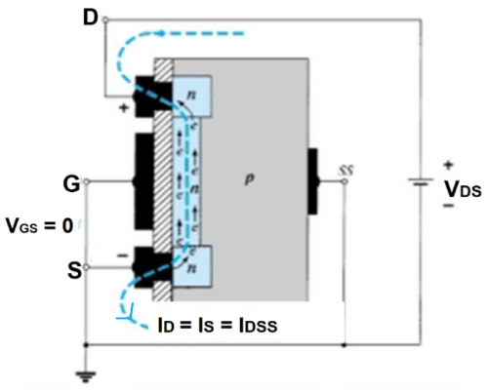
Circuit Operation of D-MOSFET
Depletion Mode: The working of a n-channel depletion type MOSFET is almost similar to the working of a n-channel JFET.
Channel is here from the beginning and the substrate terminal is connected to the Source internally.
Case 1:
At first, gate-to-source voltage is set to zero and a positive voltage VDS is applied across the drain-to-source terminals. The result is an attraction for the positive potential at the drain by the free electrons of the n-channel. As current flows in the opposite direction of electrons, current ID will start flowing. As we increase VDS current ID will also increase until VDS reaches a specific value.
As VDS increases, N type material will be more reverse biased, therefore depletion region will be wider and the channel will become narrower. At some point ID will become constant after reaching a maximum value IDSS
Prepared by Ipshita Tasnim Raha
Notes:
Reference book: Vk Mehta – pg 537

Slide 14
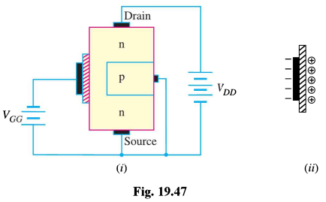
Case 2
VGS now has been set at a negative voltage such as VGS= -1 V. The negative
potential at the gate will tend to pressure electrons toward the p-type substrate and attract holes from the p-type. Depending on the magnitude of the negative bias established by
VGS, a level of recombination between electrons and holes will occur that will reduce
the number of free electrons in the n-channel available for conduction. The more negative
the bias, the higher the rate of recombination. The resulting level of drain current
is therefore reduced

Slide 15
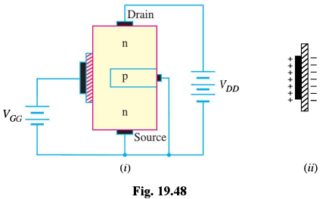
Circuit Operation of D-MOSFET
Case 3
ii) Enhancement Mode:
D- MOSFET operates in “enhancement region” for positive values of VGS. If a positive voltage, let VGS=+1 V, is applied between the gate and source terminal, then gate will be forward biased. The positive gate will draw additional electrons (free carriers) from the p-type substrate. Therefore the total number of carriers in the channel will increase and drain current ID will also increase. If VGS is further increased, then the value of ID keeps increasing and could possibly exceed the maximum current rating for the device.
We can say, the application of a positive gate-to-source voltage has “enhanced” the level of free carriers in the channel. For this reason, the region of positive gate voltages on the drain or transfer characteristics is often referred to as the enhancement region.
Example 5.3 (DIY)
Prepared by Ipshita Tasnim Raha
Notes:
Reference book: Vk Mehta – pg 538

Slide 16
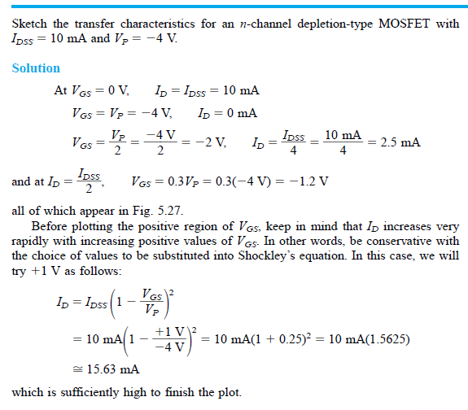
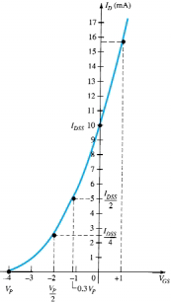

Slide 17
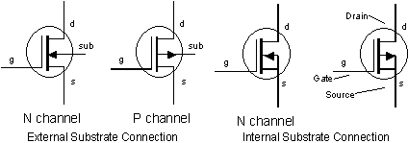
Symbols for D-MOSFET: There are two types of D-MOSFETs. They are, (i) n-channel D-MOSFET. (ii) p-channel D-MOSFET.
P Channel
Prepared by Ipshita Tasnim Raha
Notes:
https://www.youtube.com/watch?v=Bfvyj88Hs_o&t=197s

Slide 18
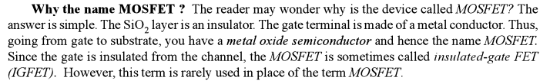
Prepared by Ipshita Tasnim Raha

Slide 19
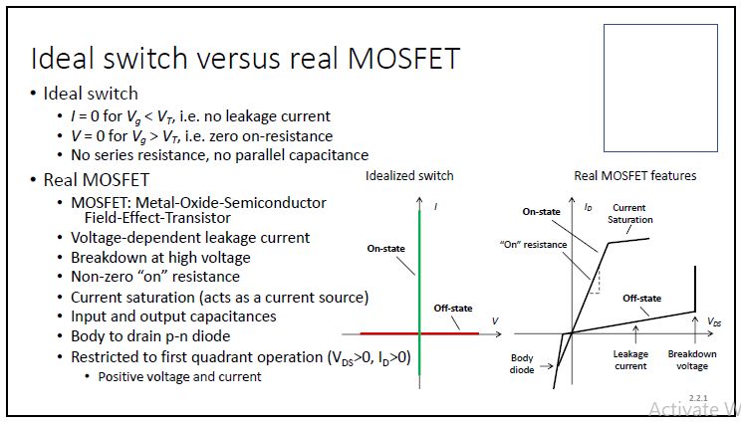

Slide 20
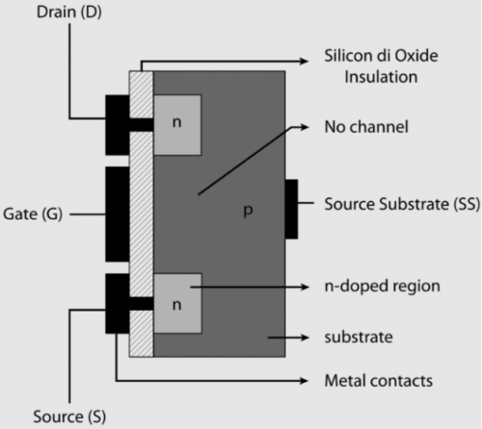
E-MOSFET
Above figure shows the constructional details of
n-channel E-MOSFET. Its gate construction is similar to that of D-MOSFET. The E-MOSFET has no channel between source and drain unlike the D-MOSFET. Note that the substrate extends completely to the SiO2 layer so that no channel exists. The E-MOSFET requires a proper gate voltage to form a channel (called induced channel). It is reminded that E-MOSFET can be operated only in enhancement mode. In short, the construction of E-MOSFET is quite similar to that of the D-MOSFET except for the absence of a channel between the drain and source terminals.

Slide 21
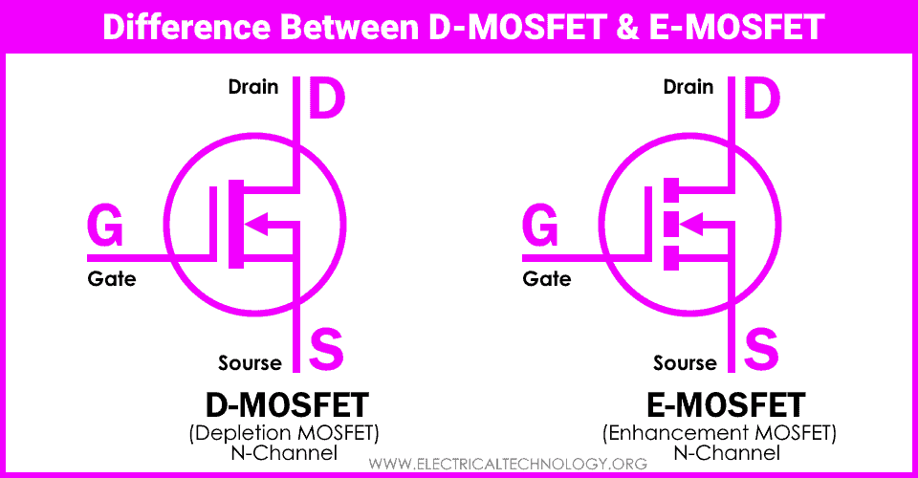

Slide 22
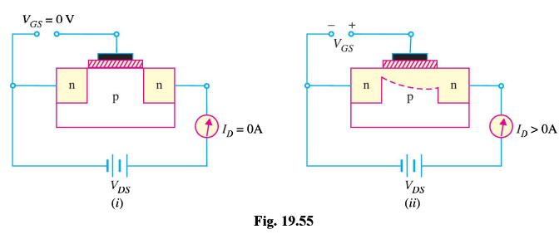
Circuit Operation of E-MOSFET
If VGS is set at 0 V and a voltage applied between the drain and source of the device, the absence of an n-channel will result in a current of effectively zero amperes.
Therefore ID=0 A at VGS=0
Prepared by Ipshita Tasnim Raha
Notes:
Reference book: Vk Mehta – pg 543

Slide 23
In Fig. (ii) both VDS and VGS have been set at some positive voltage. This will establish the drain and gate at a positive potential with respect to the source. The positive potential at the gate will pressure the holes in
the p-substrate near the edge of the SiO2 layer to leave the area and enter deeper regions of the p-substrate. However, the electrons in the p-substrate will be attracted to the positive gate and accumulate in the region near the surface of the SiO2 layer. As VGS increases in magnitude, the concentration of electrons near the SiO2 surface
Increases and if VGS is increased to a specific value, then a channel will be induced/enhanced between two n-type materials and drain current will start flowing. As VGS is increased beyond the threshold level, drain current will further increase.
The level of VGS that results in the significant increase in drain current is called the threshold voltage and is given the symbol VT or VGS(th).

Slide 24




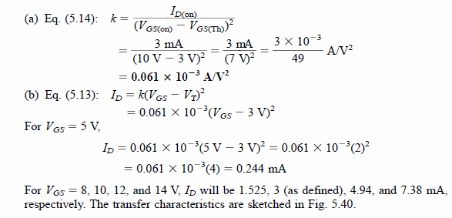
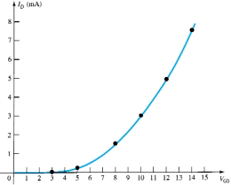

Slide 25
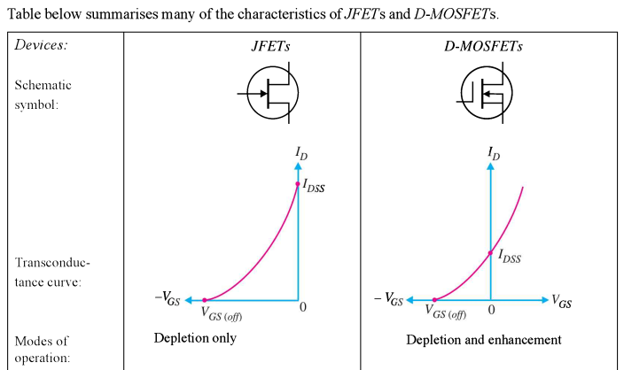
D-MOSFETs vs JFETSs
Prepared by Ipshita Tasnim Raha

Slide 26
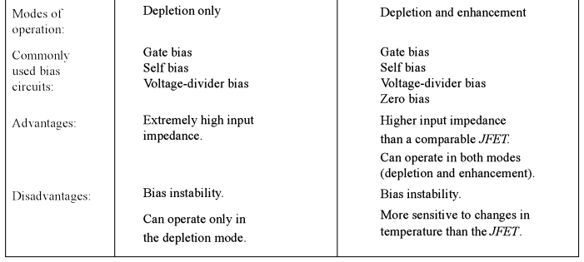
D-MOSFETs vs JFETSs
Prepared by Ipshita Tasnim Raha

Slide 27
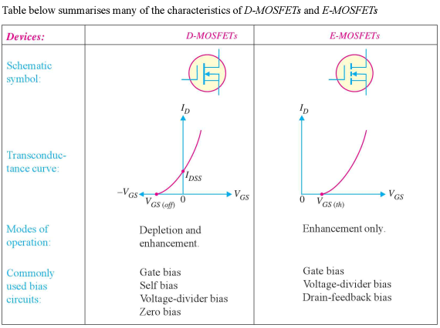
D-MOSFETs vs E-MOSFETs
Prepared by Ipshita Tasnim Raha

